Slide 1

Facebook engagement analysis report Data-driven insights from organizational posts Time series analysis to find best time to post to maximize audience response
SREEMA K R

Slide 2
OBJECTIVE
The objective of this use case is to find the best times for a user to post on social networks in order to maximize the probability of audience responses
NOTATIONS USED IN THIS USECASE
Notations | Explanation
Tk | 15 minute timespan(one bucket size). Four buckets represent one hour
ck(p) | Number of posts created in time bucket k in a day
Ck(p) | Estimated number of posts created by page p, in each time bucket tk
rk(u) | Reactions done by users of page p in each time bucket tk
Qk(p) | Estimated number of reactions received by page p in time bucket tk
Sk(p) | Probability of receiving reactions on page in each time bucket tk
Ak(C) | Aggregated no of posts created by category C in each time bucket tk
W(p) | Fraction of reaction received by a page p in its category
RG(p,k) | Reaction gain of a page p at time bucket k

Slide 3
DATASET
Datasets used in this use case
Post Summary.xlsx
Comments.xlsx
DATASET SCHEMA
Table | Columns
Post Summary | pid, category, postedBy, createdTime, message, likesCount
Comments | pid, commentsText
CONSTRAINTS
In Comments table there are many comments (in first row of Comments table itself) and comments are separated by special symbols ?#+@ (and comment time is there at the end of every comment)

Slide 4
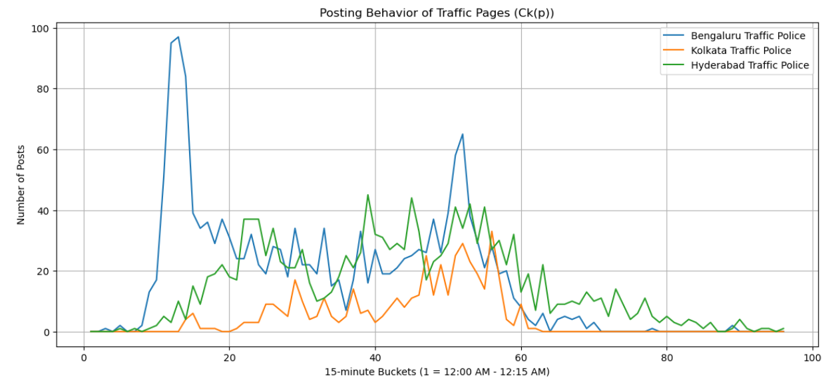
EXERCISE 1
OBJECTIVE : To analyze the posting behavior of Facebook Pages using the PostSummary table
REQUIREMENTS & CONSIDERATIONS
Divide 24 hours of a day into 96 buckets each of 15 minute and create a vector Ck(p) for post profile as Ck (p) = [C1 (p),….. ,C96 (p)] ; k= 1, 2, 3, …,96
Plot the graphs of aggregated no of posts Ck(p) for daily analysis of the following four Traffic Pages namely Bengaluru Traffic Police, Kolkata traffic police and Hyderabad Traffic Police.

Slide 5
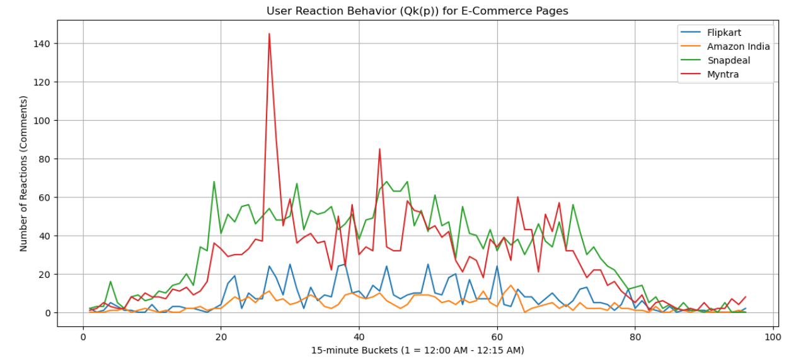
EXERCISE 2
OBJECTIVE : To analyze the the reactions behavior of users on Facebook Pages using the Comments table.
REQUIREMENT & CONSIDERATIONS
Iterate through reaction profile r(u) of users on each page p & each column contains multiple comments separated by ?#+@ followed by its time stamp. You have to extract the time stamp for each comment
Plot the graphs of estimated number of reactions Qk(p) for daily analysis for the following four e- commerce Pages namely Flipkart, Amazon, Snapdeal and Myntra.

Slide 6
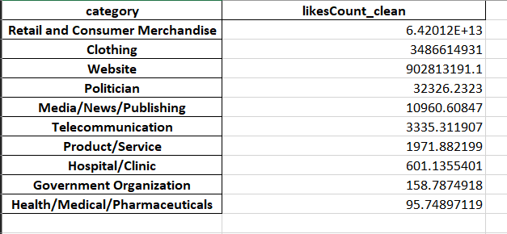
EXERCISE 3 (Generating excel)
OBJECTIVE : To create an excel chart to calculate the average number of likes per post for each category
REQUIREMENT & CONSIDERATIONS
Compute the average likes per post for each category
Create an excel ‘average_likes_per_category.xlsx’ grouping likes count in post summary by category

Slide 7
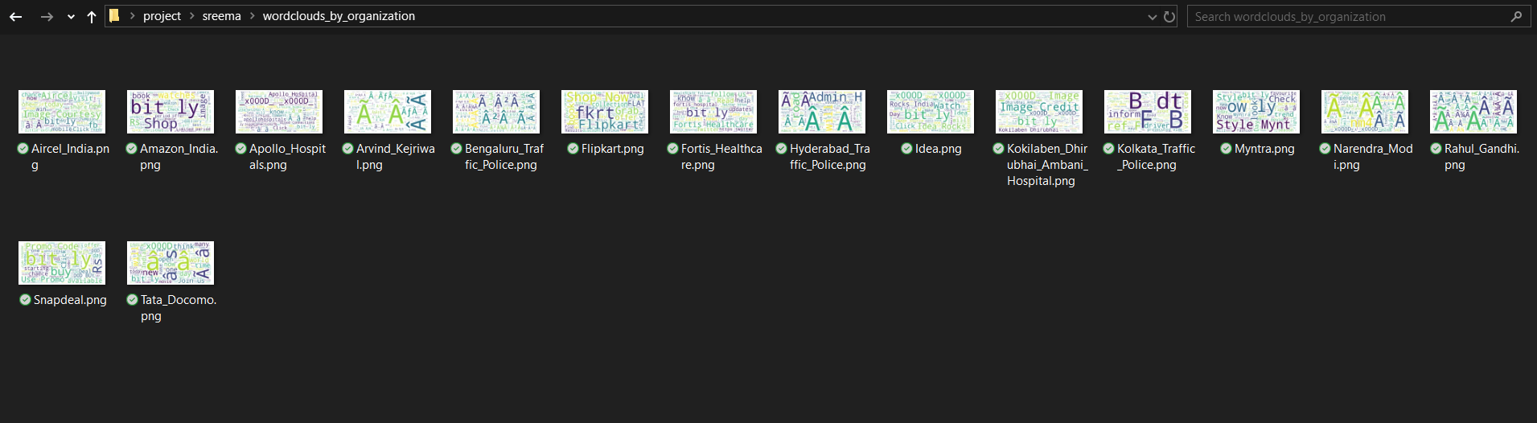
EXERCISE 3 (Generating word cloud)
OBJECTIVE : To create a word cloud for each organization (PostedBy).
APPROACH
Used message column from post summary of each organization
Created a folder ‘wordclouds_by_organization’ and saved all word clouds for each organization as a separate image file

Slide 8
INSIGHTS
Category | Traffic page
Leading category (highest total count) | Bengaluru Traffic Police
Least category (lowest total count) | Kolkata Traffic Police
Exercise 1 : Engagement analysis of the traffic pages
Category |  | Bengaluru Traffic Police | Hyderabad Traffic Police | Kolkata Traffic Police
Max count |  | 97 (Bucket 13 : 03:00 AM - 03:15 AM) | 45 (Bucket 39 : 09:30 AM - 09:45 AM) | 33 (Bucket 56 : 01:45 PM - 02:00 PM)
Min count |  | 0 (Bucket 1 : 12:00 AM - 12:15 AM) | 0 (Bucket 1 : 12:00 AM - 12:15 AM) | 0 (Bucket 1 : 12:00 AM - 12:15 AM)
Average count |  | 16.91 | 14.92 | 4.66
Count Ranges | 0 counts | 30 | 10 | 49
 | 1 to 10 counts | 16 | 36 | 30
 | 11 to 25 counts | 23 | 27 | 15
 | 26 to 50 counts | 21 | 23 | 2
 | > 50 counts | 6 | 0 | 0
Time slots with 0 counts |  | 12:00 AM - 12:15 AM, 12:15 AM - 12:30 AM, 12:45 AM - 01:00 AM, 01:15 AM - 01:30 AM, 01:30 AM - 01:45 AM, 03:45 PM - 04:00 PM, 05:30 PM - 05:45 PM, 05:45 PM - 06:00 PM, 06:00 PM - 06:15 PM, 06:15 PM - 06:30 PM, 06:30 PM - 06:45 PM, 06:45 PM - 07:00 PM, 07:00 PM - 07:15 PM, 07:30 PM - 07:45 PM, 07:45 PM - 08:00 PM, 08:00 PM - 08:15 PM, 08:15 PM - 08:30 PM, 08:30 PM - 08:45 PM, 08:45 PM - 09:00 PM, 09:00 PM - 09:15 PM, 09:15 PM - 09:30 PM, 09:30 PM - 09:45 PM, 09:45 PM - 10:00 PM, 10:15 PM - 10:30 PM, 10:30 PM - 10:45 PM, 10:45 PM - 11:00 PM, 11:00 PM - 11:15 PM, 11:15 PM - 11:30 PM, 11:30 PM - 11:45 PM, 11:45 PM - 12:00 AM | 12:00 AM - 12:15 AM, 12:15 AM - 12:30 AM, 12:30 AM - 12:45 AM, 12:45 AM - 01:00 AM, 01:15 AM - 01:30 AM, 01:45 AM - 02:00 AM, 09:30 PM - 09:45 PM, 09:45 PM - 10:00 PM, 10:45 PM - 11:00 PM, 11:30 PM - 11:45 PM | 12:00 AM - 12:15 AM, 12:15 AM - 12:30 AM, 12:30 AM - 12:45 AM, 12:45 AM - 01:00 AM, 01:00 AM - 01:15 AM, 01:15 AM - 01:30 AM, 01:30 AM - 01:45 AM, 01:45 AM - 02:00 AM, 02:00 AM - 02:15 AM, 02:15 AM - 02:30 AM, 02:30 AM - 02:45 AM, 02:45 AM - 03:00 AM, 03:00 AM - 03:15 AM, 04:30 AM - 04:45 AM, 04:45 AM - 05:00 AM, 03:30 PM - 03:45 PM, 03:45 PM - 04:00 PM, 04:00 PM - 04:15 PM, 04:15 PM - 04:30 PM, 04:30 PM - 04:45 PM, 04:45 PM - 05:00 PM, 05:00 PM - 05:15 PM, 05:15 PM - 05:30 PM, 05:30 PM - 05:45 PM, 05:45 PM - 06:00 PM, 06:00 PM - 06:15 PM, 06:15 PM - 06:30 PM, 06:30 PM - 06:45 PM, 06:45 PM - 07:00 PM, 07:00 PM - 07:15 PM, 07:15 PM - 07:30 PM, 07:30 PM - 07:45 PM, 07:45 PM - 08:00 PM, 08:00 PM - 08:15 PM, 08:15 PM - 08:30 PM, 08:30 PM - 08:45 PM, 08:45 PM - 09:00 PM, 09:00 PM - 09:15 PM, 09:15 PM - 09:30 PM, 09:30 PM - 09:45 PM, 09:45 PM - 10:00 PM, 10:00 PM - 10:15 PM, 10:15 PM - 10:30 PM, 10:30 PM - 10:45 PM, 10:45 PM - 11:00 PM, 11:00 PM - 11:15 PM, 11:15 PM - 11:30 PM, 11:30 PM - 11:45 PM, 11:45 PM – 12:00AM
Time slots with >50 counts |  | 02:30 AM - 02:45 AM, 02:45 AM - 03:00 AM, 03:00 AM - 03:15 AM, 03:15 AM - 03:30 AM, 12:30 PM - 12:45 PM, 12:45 PM - 01:00 PM | None | None

Slide 9
INSIGHTS
Category | Ecommerce page
Leading category (highest total count) | Snapdeal
Least category (lowest total count) | Amazon India
Exercise 2 : Engagement analysis of the ecommerce pages
Category |  | Amazon India | Flipkart | Myntra | Snapdeal
Max count |  | 14 (Bucket 62 : 03:15 PM - 03:30 PM) | 25 (Bucket 30 : 07:15 AM - 07:30 AM) | 145 (Bucket 27 : 06:30 AM - 06:45 AM) | 68 (Bucket 19 : 04:30 AM - 04:45 AM)
Min count |  | 0 (Bucket 1 : 12:00 AM - 12:15 AM) | 0 (Bucket 2 : 12:15 AM - 12:30 AM) | 1 (Bucket 1 : 12:00 AM - 12:15 AM) | 0 (Bucket 90 : 10:15 PM - 10:30 PM)
Average count |  | 3.82 | 7.15 | 26.39 | 31.40
Count Ranges | 0 counts | 18 | 13 | 0 | 5
 | 1 to 10 counts | 75 | 61 | 31 | 20
 | 11 to 25 counts | 3 | 22 | 17 | 12
 | 26 to 50 counts | 0 | 0 | 36 | 39
 | > 50 counts | 0 | 0 | 11 | 20
Time slots with 0 counts |  | 12:00 AM - 12:15 AM, 12:15 AM - 12:30 AM, 12:30 AM - 12:45 AM, 01:30 AM - 01:45 AM, 02:30 AM - 02:45 AM, 03:00 AM - 03:15 AM, 03:15 AM - 03:30 AM, 03:45 PM - 04:00 PM, 08:15 PM - 08:30 PM, 08:45 PM - 09:00 PM, 09:00 PM - 09:15 PM, 09:45 PM - 10:00 PM, 10:15 PM - 10:30 PM, 10:30 PM - 10:45 PM, 10:45 PM - 11:00 PM, 11:00 PM - 11:15 PM, 11:15 PM - 11:30 PM, 11:45 PM - 12:00 AM | 12:15 AM - 12:30 AM, 01:45 AM - 02:00 AM, 02:00 AM - 02:15 AM, 02:30 AM - 02:45 AM, 02:45 AM - 03:00 AM, 04:15 AM - 04:30 AM, 08:45 PM - 09:00 PM, 09:15 PM - 09:30 PM, 10:30 PM - 10:45 PM, 10:45 PM - 11:00 PM, 11:00 PM - 11:15 PM, 11:15 PM - 11:30 PM, 11:30 PM - 11:45 PM | None | 10:15 PM - 10:30 PM, 10:45 PM - 11:00 PM, 11:15 PM - 11:30 PM, 11:30 PM - 11:45 PM, 11:45 PM - 12:00 AM
Time slots with >50 counts |  | None | None | 06:30 AM - 06:45 AM, 06:45 AM - 07:00 AM, 07:15 AM - 07:30 AM, 09:30 AM - 09:45 AM, 10:30 AM - 10:45 AM, 11:30 AM - 11:45 AM, 11:45 AM - 12:00 PM, 12:00 PM - 12:15 PM, 03:30 PM - 03:45 PM, 04:30 PM - 04:45 PM, 05:00 PM - 05:15 PM | 04:30 AM - 04:45 AM, 05:00 AM - 05:15 AM, 05:30 AM - 05:45 AM, 05:45 AM - 06:00 AM, 06:30 AM - 06:45 AM, 07:30 AM - 07:45 AM, 08:00 AM - 08:15 AM, 08:15 AM - 08:30 AM, 08:30 AM - 08:45 AM, 08:45 AM - 09:00 AM, 09:30 AM - 09:45 AM, 10:30 AM - 10:45 AM, 10:45 AM - 11:00 AM, 11:00 AM - 11:15 AM, 11:15 AM - 11:30 AM, 11:30 AM - 11:45 AM, 12:00 PM - 12:15 PM, 12:30 PM - 12:45 PM, 01:30 PM - 01:45 PM, 05:30 PM - 05:45 PM

Slide 10
INSIGHTS
Category | Sector
Leading category (highest total count) | Retail and Consumer Merchandise
Least category (lowest total count) | Health/Medical/Pharmaceuticals
Exercise 3 : Average likes per category
Category | Likes count
Retail and Consumer Merchandise | 64201204809298.10
Clothing | 3486614931.00
Website | 902813191.10
Politician | 32326.23
Media/News/Publishing | 10960.61
Telecommunication | 3335.31
Product/Service | 1971.89
Hospital/Clinic | 601.14
Government Organization | 158.79
Health/Medical/Pharmaceuticals | 95.75

Slide 11
THANK YOU

